Slide 1

Partnering with Family Councils:
A Proven Path to Better Outcomes in Long-Term Care
Lisa Dawson, President, The provincial association of family councils (ILTCCABC) and Executive Member of Vancouver Association of Family Councils (VCAFC)
Barb Kirby, Advisor to VCAFC and Later Lifestyle Planner and Seniors Navigator
(Seniors Advocate.ca)

Slide 2

Why Do We Care About Long-Term Care?
Long Standing Underfunding
Long Waitlists to Access Care
Inadequate Resource Allocation and Cutbacks to Meet Growing Needs
Limited and Aging facilities with Inadequate Environments
Outdated models of care including staff to resident ratios and holistic training
This is the place where our friends, families our ourselves may end up living in the coming years!

Slide 3

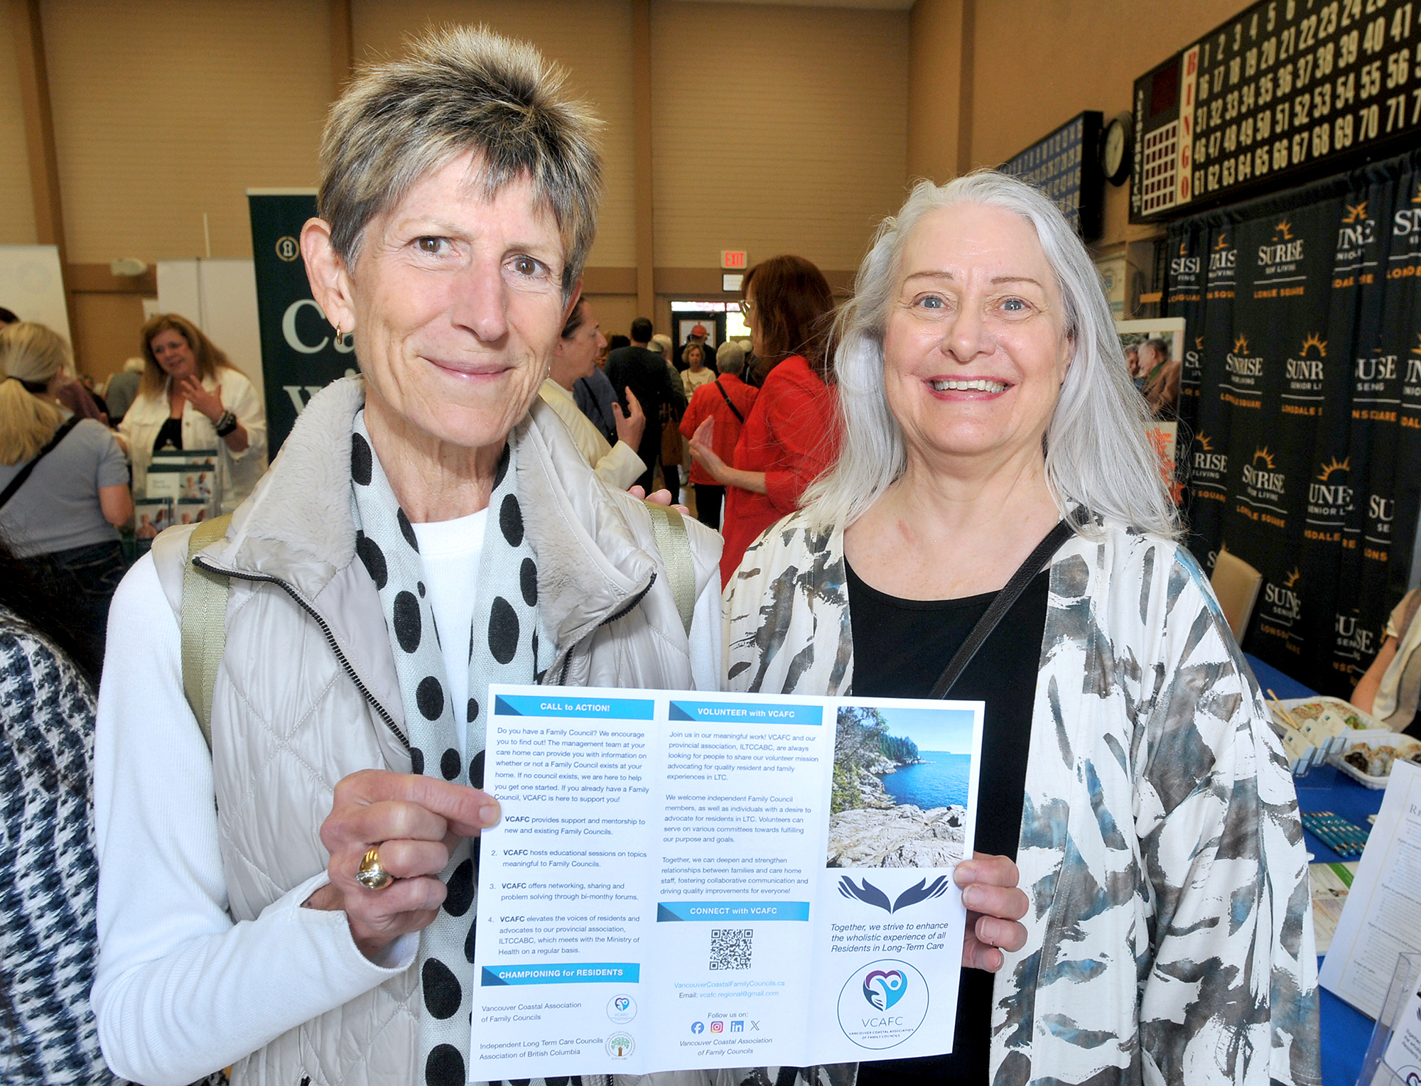
Introductions
Lisa Dawson
- Family Caregiver to Father
- Co-Chair, Louis Brier Family Council
- Executive, VCAFC vcafc.regional@gmail.com
- President, ILTCCABC
Contact: president.iltccabc@gmail.com
Barb Kirby
- Advisor to VCAFC
- Past chair of a Family Council
- Home Care and Housing Navigator
Contact: Barb@seniorsadvocate.ca
Vancouver Coastal Association
of Family Councils
VCAFC Pamphlet: CLICK HERE
VCAFC Website: CLICK HERE

Slide 4
WHAT IS A FAMILY COUNCIL?
In long-term care homes, a Family Council is a group of people who meet regularly to share observations and experiences with the intent to collaborate with long-term care management to improve residents’ quality of care and quality of life.
Councils offer a sense of community.

Slide 5
What does a family council do?
Offer Peer to peer support, reducing frustration, and feelings of isolation
Offer recognition for what is working well (celebrating acts of successful care and kindness)
Contribute to care home decision making by raising the collective voice to care home management
Educate families on important matters such as advanced care planning, resident health challenges and the long-term care home and system in BC
Elevate systemic issues and recommendations to the regional and provincial long-term care levels

Slide 6
TODAY’S Learning outcomes
How families of long-term care residents can help advance quality of life for residents through strengthening relationships, and collaborative problem-solving.
Practical examples of how councils reduce conflict, build trust, and create shared solutions—transforming families from visitors into valued partners in long-term care

Slide 7
Your Voice Holds Tremendous influence
The most common way people give up their POWER is by thinking they don’t have any”
Alice Walker

Slide 8
Family council values
5 top valuES to long-term care: examples without a family council and then with a family council
1. Encourage and offer support
2. Help Deepen relationships
3. Problem Solve
4. Communicate and educate
5. Advocate

Slide 9

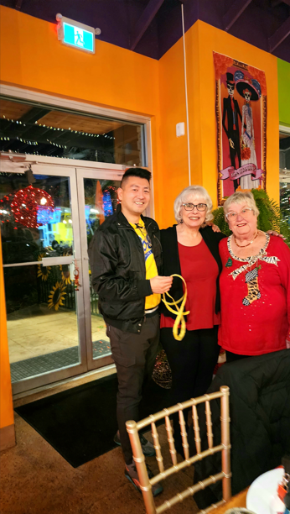
1. Encourage and offer support
for one another; reducing a sense of isolation, helplessness, frustration.

Slide 10
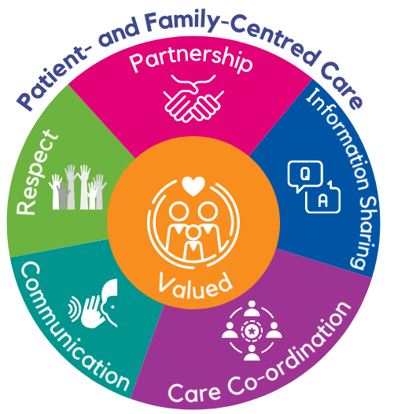
2. Deepen relationships and influence a relational approach to long-term care
between resident, family, and LTCH Staff by fostering mutual understanding and collaborative conversation.
Inviting staff to family council meetings to share what they do and answer questions
ILTCCABC Education Session: Building a Positive Council-Operator Relationship in Long-Term Care April 7, 2026

Slide 11
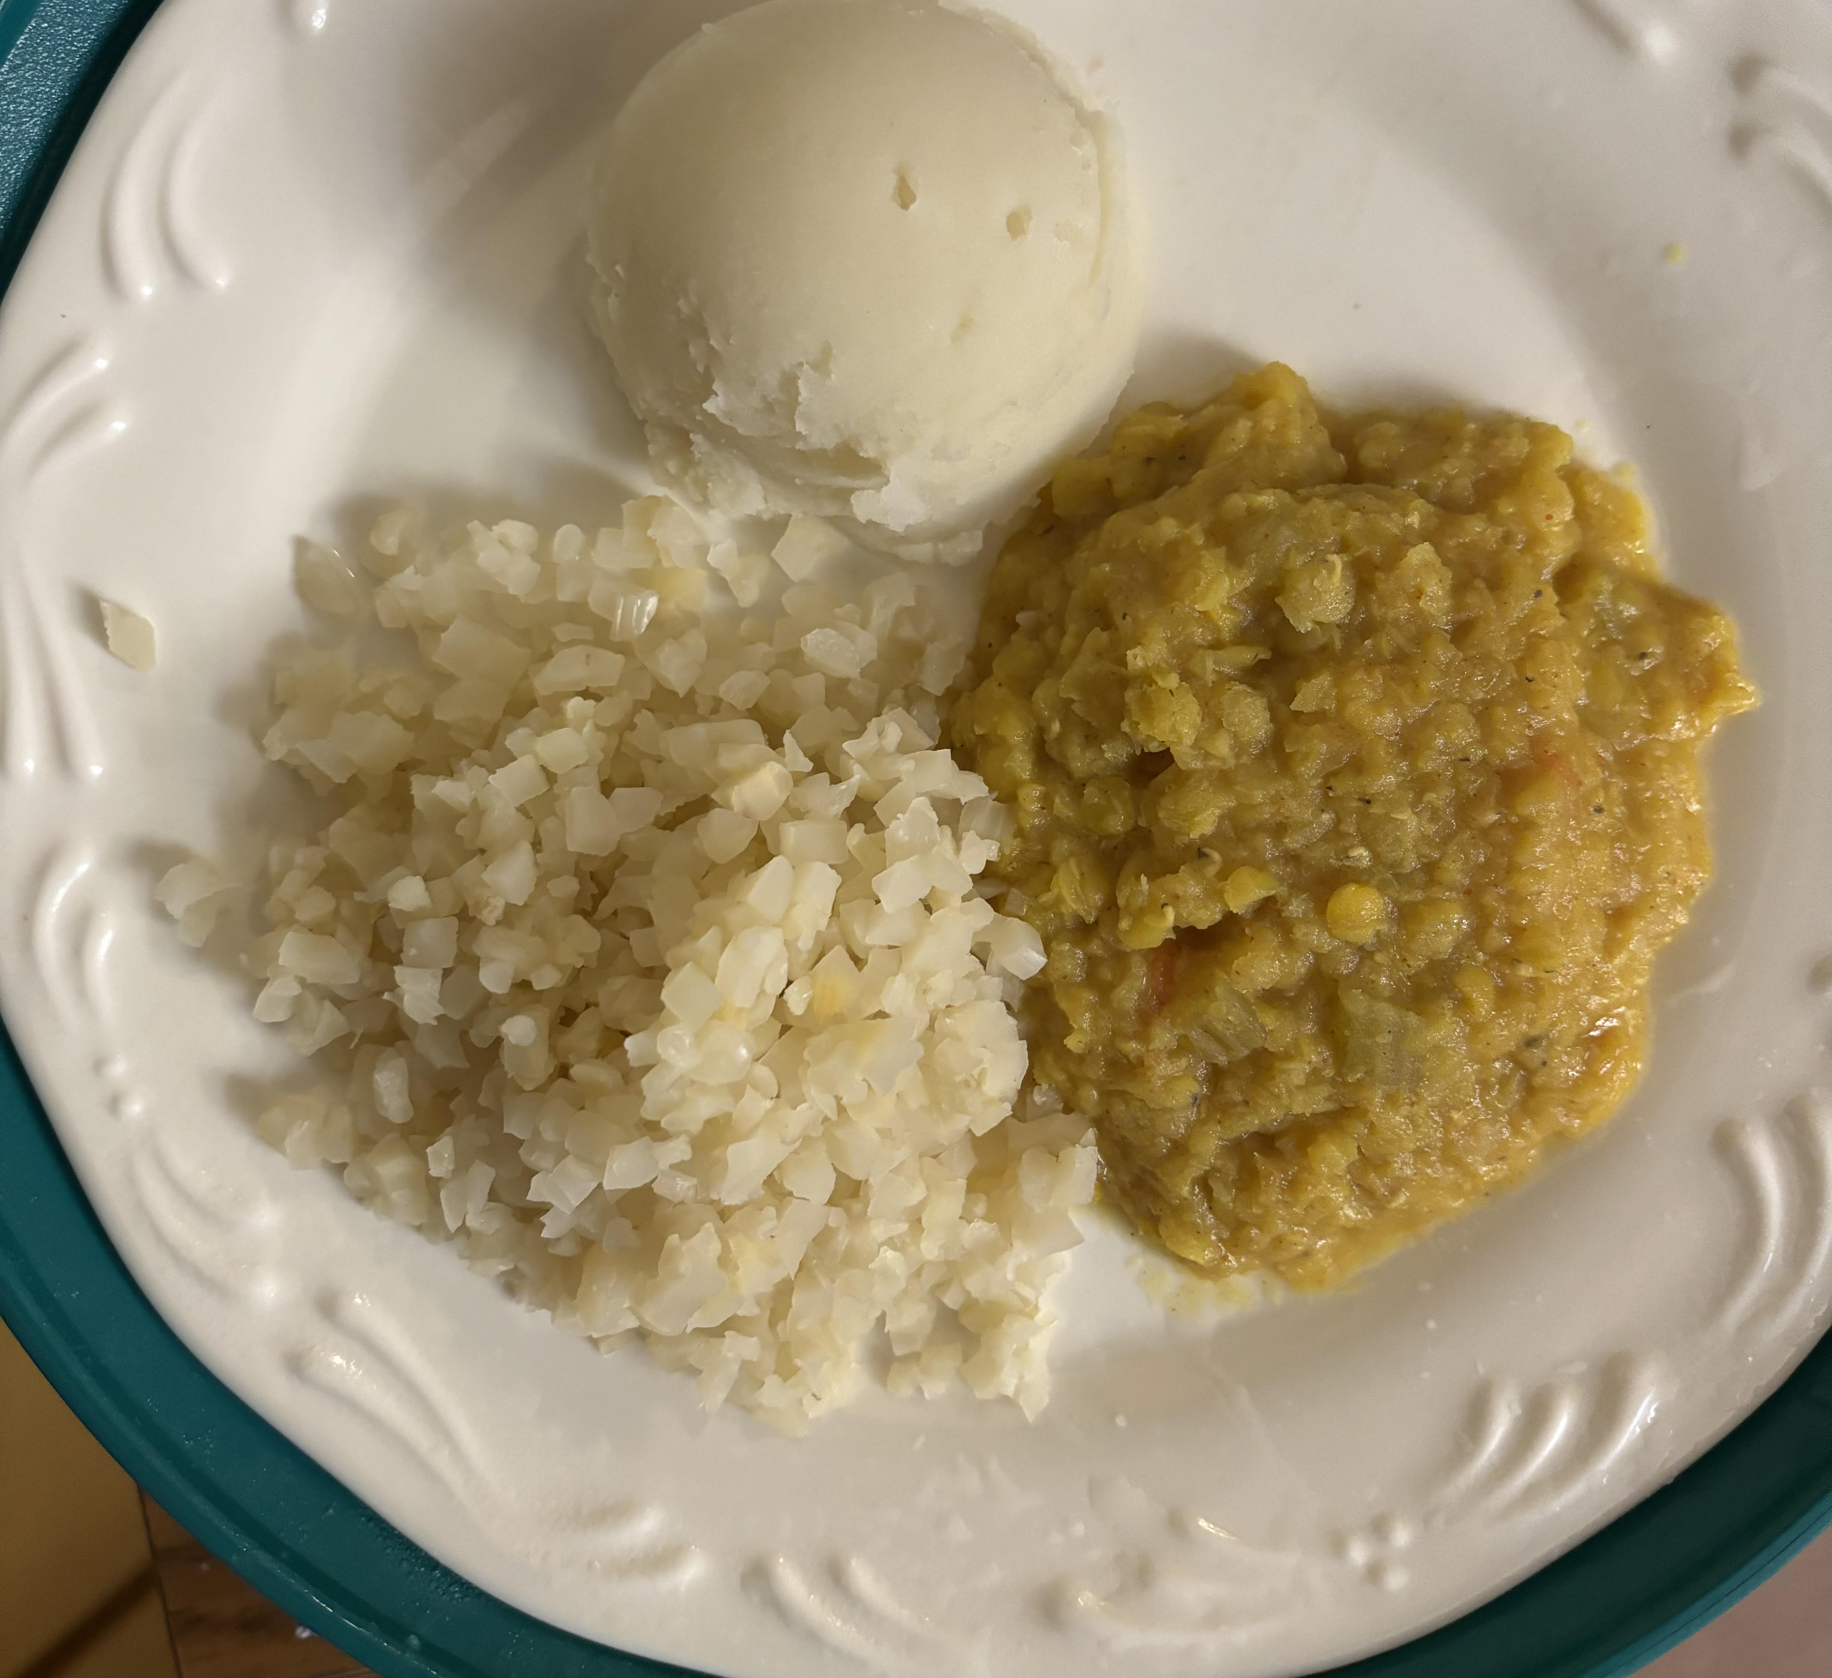
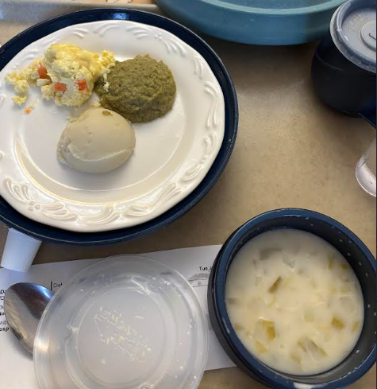
3. Problem solve
Identify issues,
Learn about the current process,
Provide recommendations,
Discuss solutions with management,
Celebrate successes,
Advocate for continuous quality improvement within the long-term care home.

Slide 12

4. Communicate and educate
About your care home (policies, procedures, care team, etc.)
About issues relating to residents and the long-term care system (dementia, diabetes, food, recreation etc.)
About how to influence change based on common ground: resident well being

Slide 13
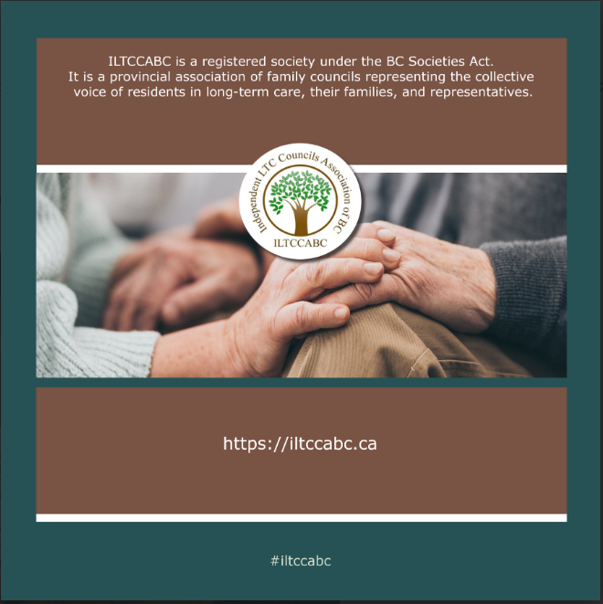

5. advocate
At the long-term care home level
- Family Council meetings with leadership
At the regional level
- The VCAFC Family Council Forums
- The VCH Regional Resident Family Council Networks
At the provincial level
- The Independent Long-Term Care Councils Association of BC (ILTCCABC)
- The Provincial Forum for Resident and Family Councils

Slide 14
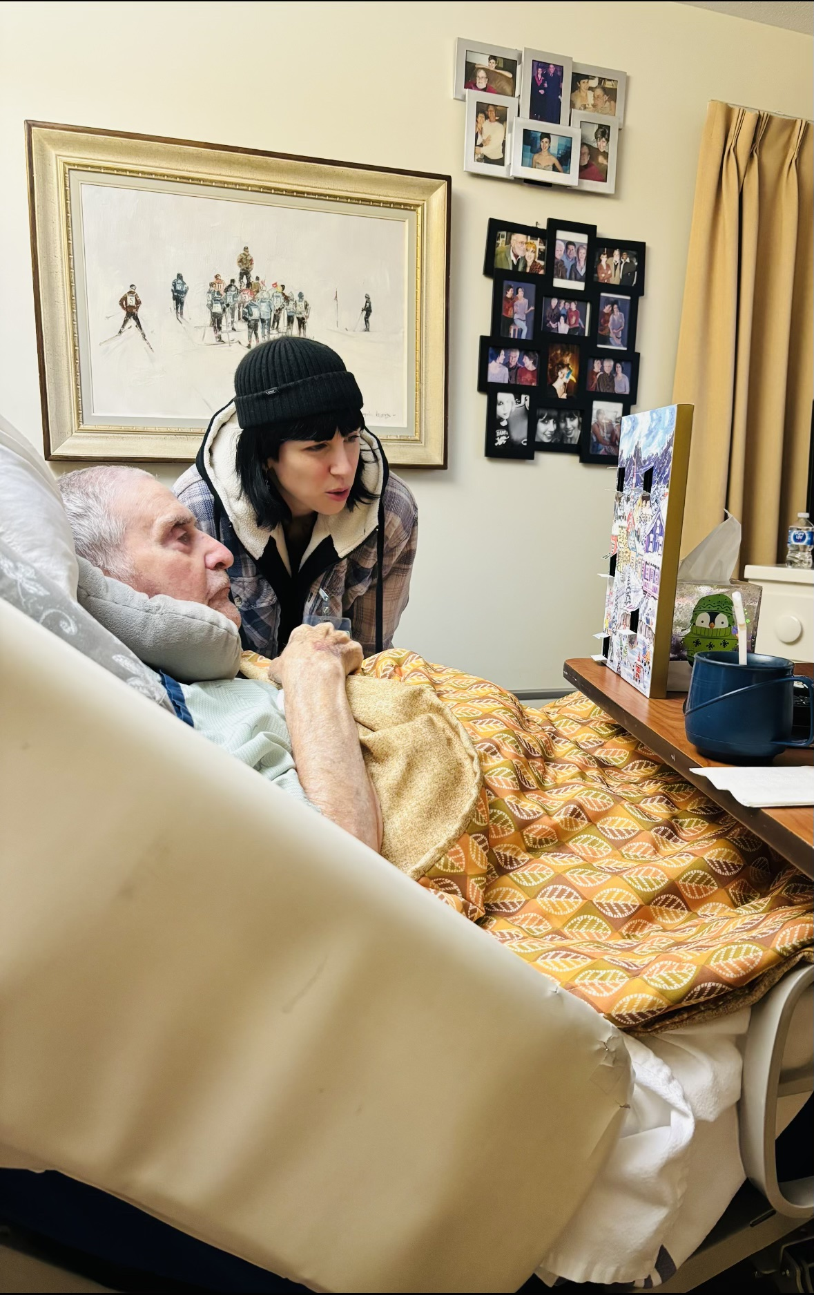
VCAFC long-term care history before covid
isolated,
frustrated,
no mechanism of communication,
every resident and family for themself,
no education on how to be a family caregiver to someone in long-term care
no knowledge of what’s next.

Slide 15
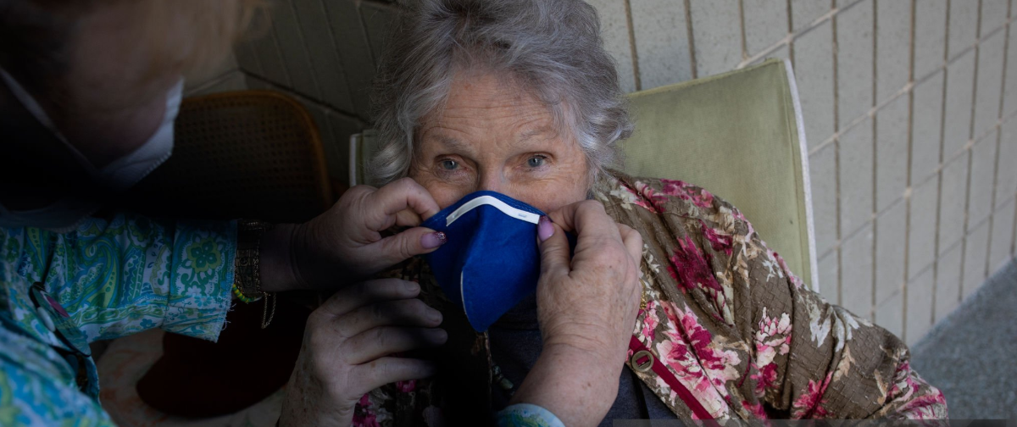
During covid
Policy making without engagement of the stakeholders to whom these policies had devastating effects
Family caregiver Lock outs, single site rules and other decisions reduced staff, locked out family caregivers and we all know the rest….

Slide 16
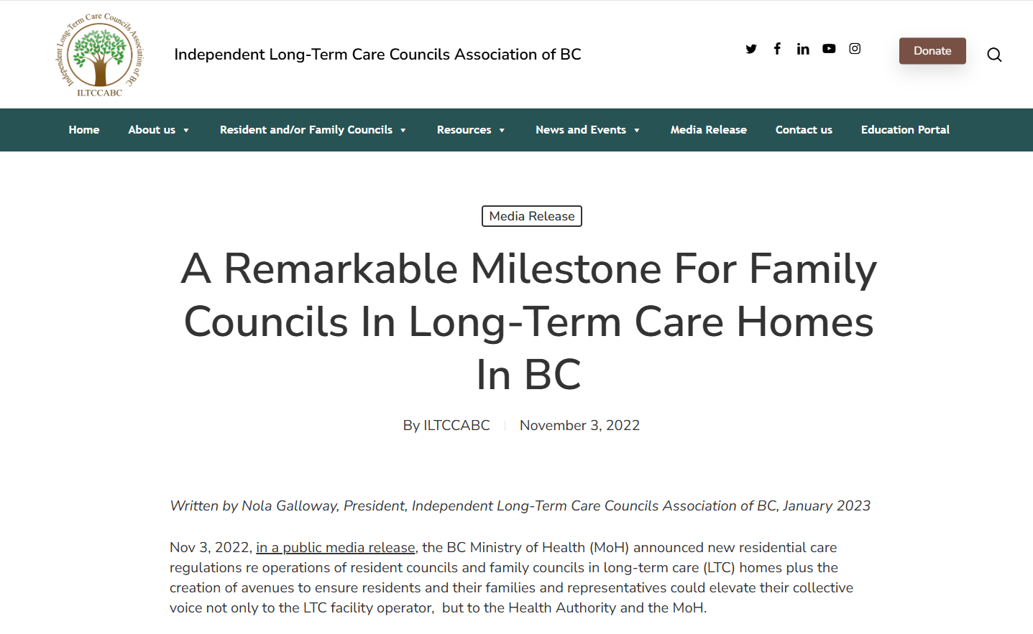
VCAFC history – the remarkable milestone

Slide 17

VCAFC CORE WORK
- To promote Councils in long-term care homes across BC;
- To support the growth and sustainability of Family Councils through mentoring and sharing of resources;
- To advance the collective voice directly to the regional level and onto the Ministry of Health;
- Raise awareness the Family Caregiver role has evolved, grown and been recognized for the advocate and partner it has become.
- Your role as a senior in the community has never been so vital and so accepted.

Slide 18
summary
Engagement between the care team and residents and their families is now, in BC, a clear mechanism of relationship building that creates better outcomes for the whole care home community.
This engagement gives us a permission to be curious like never before. Be the voice of needs, wants and wishes of residents.
Together We Improve Quality of Life in Long-Term Care

Slide 19

Questions ?
Lisa Dawson, President
Independent Long-Term Care Councils Association of BC
(ILTCCABC)
Barb Kirby, Advisor to VCAFC and Later Lifestyle Planner and Seniors Navigator (Seniors Advocate.ca)

